Slide 1


DeltaCFS: Boosting Delta Sync for Cloud Storage Services by Learning from NFS
Quanlu Zhang*, Zhenhua Li§, Zhi Yang*, Shenglong Li*,
Shouyang Li*, Yangze Guo*, and Yafei Dai*
*Peking University, §Tsinghua University

Slide 2




Background
Emerging of consumer oriented cloud storage services
  Dropbox
  OneDrive
  iCloud Drive
  Google Drive
  … …
Sync data among multiple devices in a timely manner
Notes:
There has been a lot of consumer oriented cloud storage services, such as dropbox, onedrive, icloud drive, and google drive.
They can synchronize data among multiple devices in a timely manner.

Slide 3





Cloud-based data sync
Notes:
Here is how cloud-based data sync works. When a file is modified on a device, this device will upload this file onto the cloud, then, the cloud forwards it to other linked devices.

Slide 4

Existing data sync approaches
Whole file data sync (inotify)
Data Sync App
Update
inotify
OS
File system
Cloud copy
Local copy
A lot of traffic
Notes:
Let’s look at two existing approaches for data sync. The simplest one is whole file data sync. Here is an example, a user modifies a file in local file system, data sync app finds this modification through inotify, and then upload the whole file onto the cloud. The problem of this approach is that it would generate large amount of network traffic.

Slide 5

Existing data sync approaches
Delta encoding (inotify+rsync)
Data Sync App
Update
Inotify
OS
File system
Cloud copy
High CPU overhead
Local copy
Notes:
Another approach is delta encoding, which can be implemented through inotify and rsync. The representative application that applies this approach is dropbox. Here is how it works. A user modified a file, data sync app finds this modification and retrieve checksums of this file from cloud, the local copy is compared with these checksums to get the modified part. Then this modified part is uploaded onto cloud. Though network traffic is reduced, it generates high CPU overhead.

Slide 6
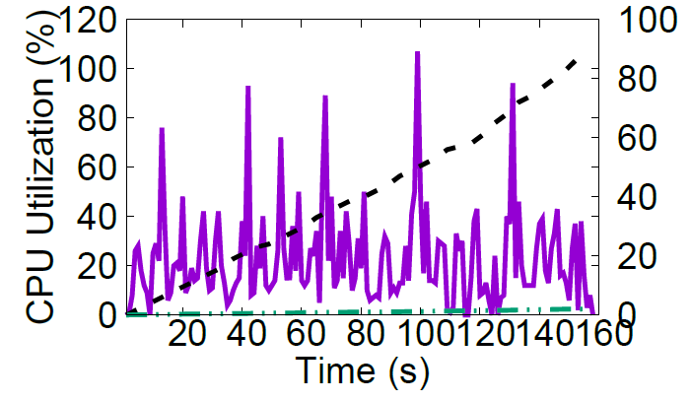
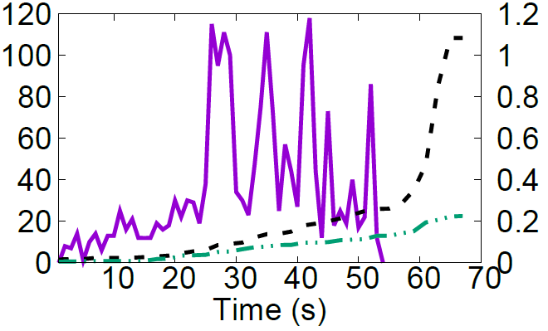

Measurement -- PC
Sync files through Dropbox
Microsoft Word trace
SQLite trace
Notes:
We measured dropbox’s CPU and network consumption by running two collected real world traces. The first one is Microsoft work editing trace, and the other one is sqlite trace, which is a lightweight database file, widely used in desktop and mobile applications. We can see that the cpu overhead is high during running these traces, sometimes the cpu utilization is higher than 100%.

Slide 7
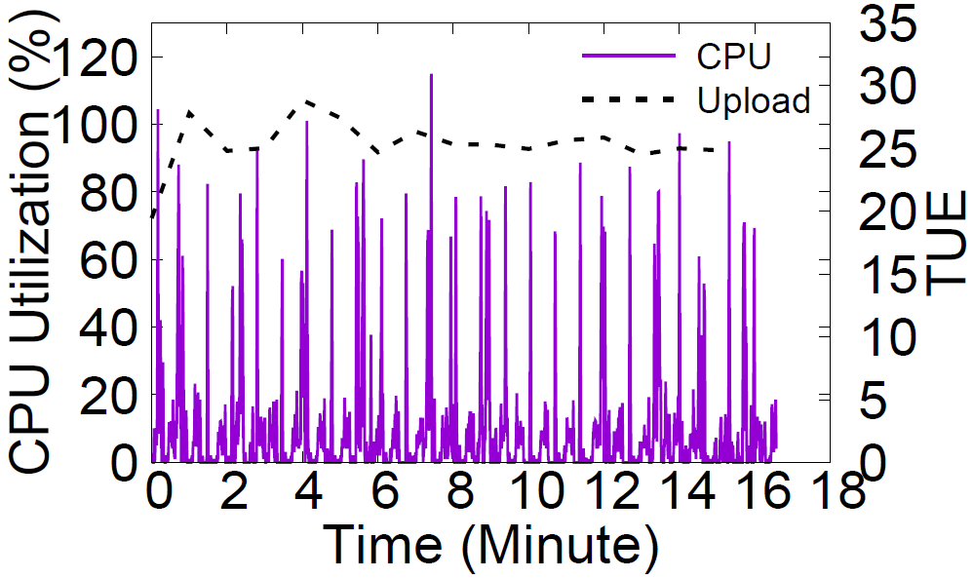

Measurement -- mobile
Sync WeChat data through Dropbox (without rsync)
  Average CPU utilization is 9%
  Traffic amplification is around 25
TUE：Traffic Usage Efficiency
i.e., $\frac{network traffic}{modified bytes}$
Notes:
Due to its high computation overhead, dropbox on mobile does not apply rsync. If a file is modified, it directly upload the whole file. We synchronize the data of wechat, a popular live chat application on mobile through dropbox. The average cpu utilization is 9%, not very high, but there are a lot of spikes. The network traffic amplification, however, is as high as 25. That is, the generated network traffic is 25 times of the modified bytes.

Slide 8
Propagation of corrupted data
corruption
Data Sync App
Update
Inotify
OS
File system
Cloud copy
Local copy
Notes:
Besides network and cpu resource consumption, cloud-based data synchronization has its specific problems. The first one is propagation of corrupted data. Here is an example, a file in local file system is corrupted due to certain reason, the user does not notice this data corruption, and modifies the file. The data sync app finds this modification and retrieves checksums from cloud in order to extract the modified parts, which would include both the modification by the user and the corrupted data. After this synchronization, the file on the cloud is corrupted. Then the file on other linked devices will also become corrupted.

Slide 9



Causing data inconsistency
inconsistency
Data Sync App
Update
Inotify
OS
File system
Cloud copy
Local copy
Notes:
Another problem is data inconsistency. We also use an example to illustrate this problem. There are two files in local file system. An image file and its thumbnail. The thumbnail is generated from the image file. Existing data sync applications tend to synchronize small files first. After the thumbnail is uploaded, the client fails. Then the files on the cloud become inconsistent, because the thumbnail is the newest, while the image file is not. This would not happen if data sync follows causality. And the violation of causality might lead to unpredictable behavior of applications on other linked devices.

Slide 10
Problems of existing data sync systems
High network traffic or High CPU overhead
Propagation of corrupted/inconsistent data
High network efficiency
Low computation overhead
Guarantee causal consistency
Detect corrupted data
Notes:
We have seen that existing data sync systems suffer from high network traffic or high computation overhead, and propagation of corrupted and inconsistent data. For the first problem, our goal is to achieve both high network efficiency and low computation overhead. For the second problem, we want to guarantee causal consistency during synchronizing files, and detect corrupted data to avoid its propagation among cloud and linked devices.

Slide 11
Key idea
The efficiency of incremental data sync can be greatly improved by intercepting file operations. It also facilitates the detection of corrupted and inconsistent data
User space File system
OS
File system
Notes:
The key idea of our design is that we find that the efficiency of incremental data sync can be greatly improved by intercepting file operations. On the other hand, it also facilitates the detection of corrupted and inconsistent data. In order to intercept file operations, we use user space file system.

Slide 12
How to achieve high network efficiency and low CPU overhead?
Adaptively apply different sync approaches for different file update patterns
In-place update
  Less write amplification
Transactional update
  Guaranteeing file integrity
Notes:
The first challenge is how to achieve high network efficiency and low CPU overhead. Our solution is adaptively applying different data sync approaches for different file update patterns. File update patterns can be summarized into two categories: in-place update and transactional update. In-place update is for less write amplification, when we update a file, we only write the modified parts into the file, while keeping the rest of the file untouched. Transactional update is widely used to guarantee file integrity, especially during system or application crash.

Slide 13
File update patterns
In-place update
  Inotify+rsync:
    Rsync: scan the whole file
    Upload incremental data
  DeltaCFS:
    No file scan
    Obtain and upload file operations directly
inotify
扫描
SQLite, Tencent QQ, WeChat, Games …
Notes:
This is in-place update. When we modify a file, we just issue a write operation to modify a specific part, for example the row labled in red. For inotify plus rsync, it scans the whole file to extract and upload the modified parts. For our design, DeltaCFS, we do no scan the file, but just intercept the write operation including the written data. This is actually the exactly modified data. This approach saves a lot of computation resource.

Slide 14
File update patterns
Transactional update
delta
  Inotify+rsync:
    Get checksums from server
    Obtain the modified parts using rsync
  DeltaCFS:
    Keep the old and new versions of the file
    Execute the optimized rsync locally
A.tmp0
A.doc
A.tmp1
Version1
write
rename
Version2
Time Line
Version1
rename
delete
Version2
Version1
Microsoft Office, Apple iWork, Photoshop …
Notes:
Transactional update is widely used in desktop applications, such as Microsoft office, apple iwork, photoshop. We take Microsoft word as an example, when file a.doc is modified and saved, the new version is first written to a.tmp1. After that, a.doc is renamed to a.tmp0, then a.tmp1 is rename to a.doc. At this moment, a.doc becomes the new version of the file. Inotify plus rsync still uses its original way to extract and upload the modified data. For our design, we leverage the fact that at a specific time point, both the old file and the new file are stored locally. This makes it is possible to execute delta encoding more efficiently. In our system, we use rsync as the delta encoding algorithm, but we reduce rsync’s computation overhead by replacing strong checksum with bit-wize block comparison. That means the strong checksum is totally eliminated from rsync.

Slide 15
Identify transactional update
Trigger
relation table
delta
A.doc -> A.tmp0
A.tmp0
A.doc
A.tmp1
A.tmp1 -> A.doc
relation
relation
Version1
write
rename
Version2
Time Line
Version1
rename
delete
Version2
Version1
Notes:
Then the problem is how to identify transactional update. We design a relation table. Here we still use the example of word document to illustrate. After the new version is written into a.tmp1. a.doc is renamed to a.tmp0. Here we create a relation for this rename operation. Then another rename, we also create a relation for it. Here, we find that the source of an relation entry equals the destination of another one. Then we know that a.tmp0 is the old version and a.tmp1 is the new version. We can execute rsync between these two files.

Slide 16

Sync Queue
In-place update (by default)
  Batched sync
  Delayed sync
mknod
rename
write a
write a
write a
… …
write b
… …
Sync Queue
Notes:
We do not have to identify in-place update, because we assume all the files use in-place update by default. We design an auxiliary module sync queue to facilitate data upload. Here we use a small optimization, that is, all the write operations to the same file are linked together for easy batching. If another write to file a is issued, it will be directly linked behind the previous write a. We also apply delayed sync, that is, data enqueued into sync queue is not uploaded immediately but wait several seconds.

Slide 17
Sync Queue
Transactional update
Trigger
delta
A.tmp0
A.doc
A.tmp1
relation
relation
… …
Version1
write
write
rename
rename
Version2
rename
rename
Time Line
Version1
delta
delete
Version2
unlink
Version1
Sync Queue
Notes:
This is how we do data uploading for transactional update. When a.tmp1 is written, all the writes are appended into sync queue, because we assume a.tmp1 uses in-place update by default. Then the first rename, then the second rename. At this moment delta encoding is triggered by the relation table. Delta is generated and appended into sync queue. Since delta is generated, the writes to a.tmp1 become useless, so they can be removed from sync queue. At last, a.tmp0 is removed.

Slide 18

Guarantee causal consistency
Backindex for maintaining causal consistency
Log
Cloud
Client
write
rename
rename
delta
pointer
unlink
mknod
Sync Queue
Notes:
Our system guarantees causal consistency for data synchronization. If sync queue follows strict FIFO, it natively guarantees causal consistency. However, our optimizations, such as batching of the writes to the same file, deletion of enqueued file writes due to transactional update. They all violate the FIFO rule. So we design backindex to maintain causal consistency. Still using the example of word document, the writes to a.tmp1, followed by two renames, then delta is computed, after that the writes are deleted. In order to keep causal consistency, we also put a pointer there, pointing to the position of delta. The elements covered by this backindex will be upload and applied onto cloud image atomically. Then the following operations are applied one by one.

Slide 19
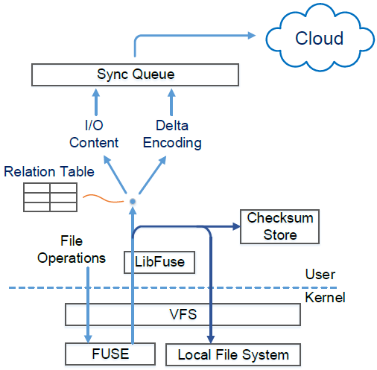
Architecture of DeltaCFS
Based on FUSE
Notes:
This is the architecture of DeltaCFS, it is based on FUSE. we use relation table to synchronize files by applying either file operation sync or delta encoding, and use sync queue to guarantee causal consistency, and maintain checksums of file blocks in checksum store to detect corrupted data.

Slide 20
Evaluation
Experiment setup
  PC: Amazon EC2 m4.xlarge (4 vCPU, Intel Xeon E5-2676, 16GB DRAM), Ubuntu 14.04 (kernel 3.13)
  Mobile: Samsung Galaxy Note3 sn9009, android 4.3 (kernel 3.4)
Traces
  Append write (40 writes, each ~800KB)
  Random write (40 writes, each 1010 bytes)
  Word edit (saved 61 times, 12.1~16.7MB)
  WeChat SQLite (modified 373 times, 131~137MB)
Notes:
We evaluated our system on PCs and mobiles using two artificial traces and two collected real world traces.

Slide 21
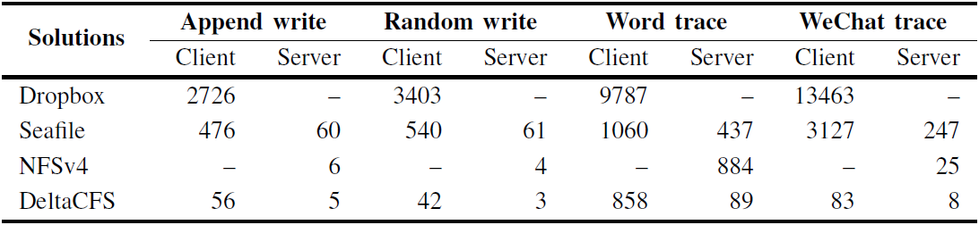
CPU consumption
CPU overhead of DeltaCFS is greatly reduced
Unit: CPU ticks
Notes:
We compared DeltaCFS with dropbox, seafile and nfsv4 on PCs. From the table, we can see that DeltaCFS consumes much less CPU resource than the other three systems, especially for append write, random write and WeChat trace, because DeltaCFS directly intercepts write operations rather than applying rsync. We also tested DeltaCFS on mobiles and compare it with dropsync which is an automatic data sync application based on dropbox. The tests show similar results to the tests on PCs. The computation overhead of DeltaCFS is small enough for mobiles.

Slide 22
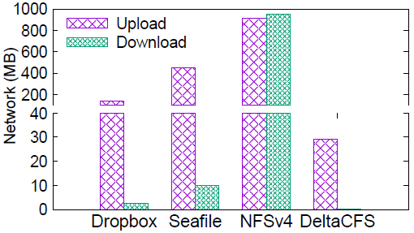
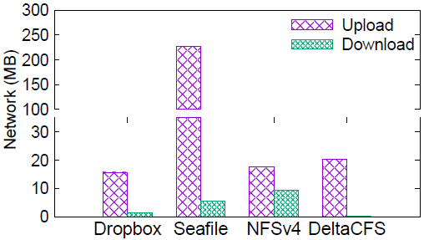
Network traffic – PC
Upload traffic is smaller than or similar to other solutions
Almost no download traffic
Word Trace
WeChat Trace
Notes:
Meanwhile, we also evaluated network traffic of these data sync systems. For word trace, DeltaCFS upload much less data than the other three, mainly because it executes delta encoding more properly with the relation table. For wechat trace, dropbox, nfs and DeltaCFS upload similar amount of data.

Slide 23
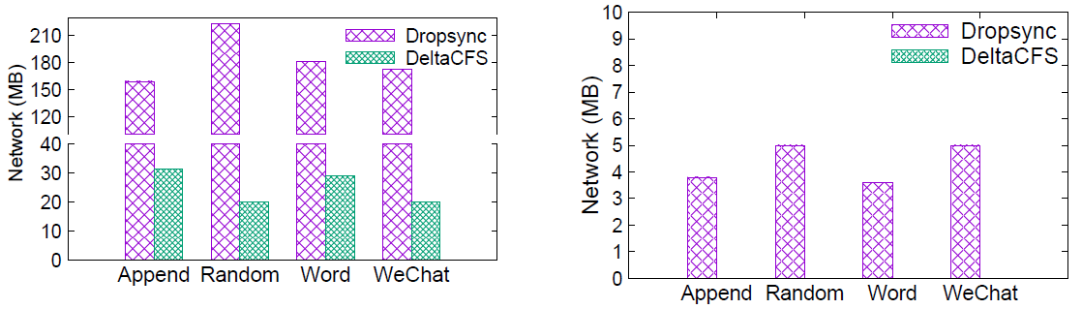
Network traffic – Mobile
Much smaller upload traffic
Almost no download traffic
Upload traffic
Download traffic
Notes:
The experiments on mobile show that DeltaCFS uploads much less data than dropsync, because we use incremental data sync while dropsync uploads whole file for each update. On the other hand, DeltaCFS has almost no download traffic, because incremental data are generated locally.

Slide 24
Summary
We pinpoint the problems of Dropbox-like cloud storage services
We design a novel file sync framework, combining delta sync and NFS-like file RPC
We design a relation table to adaptively apply different sync approaches based on file update patterns
We design a lightweight mechanism to guarantee causal consistency
The source code is available at https://github.com/QuanluZhang/DeltaCFS
Notes:
To sum up, we pinpoint the problems of dropbox-like cloud storage services, and design a novel file sync framework, which combines delta sync and NFS-like file rpc. We design a relation table to adaptively apply different sync approaches based on file update patterns. Causal consistency is guaranteed by a lightweight mechanism based on sync queue.

Slide 25
Thanks!

Slide 26
Optimized rsync
Replace strong checksum with bit-wise comparison
Old version
Server
MD5
Rolling
MD5
Rolling
MD5
Rolling
MD5
Rolling
Network
MD5
Rolling
MD5
Rolling
MD5
Rolling
MD5
Rolling
Old version
Client
New version
Rolling

Slide 27
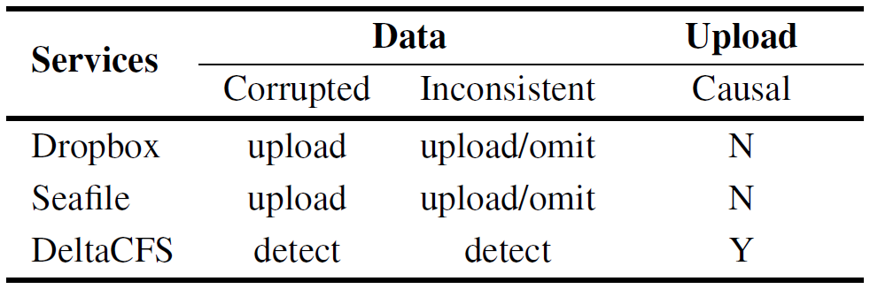
Results of reliability tests
Detect corrupted and inconsistent data
Guarantee causal consistency

